Slide 1
Apache ZooKeeper
Pravin Y Pawar
CSIS-WILP

Slide 2
BA ZC420, Real Time Analytics
Lecture No. 2.2

Slide 3

Agenda
Apache ZooKeeper Fundamentals
ZooKeeper Workflow
ZooKeeper CLI
ZooKeeper Java APIs

Slide 4
Apache ZooKeeper
Overview
  Designed at Yahoo!
  Distributed co-ordination service to manage large set of hosts
  Simple architecture and API to manage a service in a distributed environment
  Standard for organized service used by Hadoop, HBase, and other distributed frameworks

Slide 5
Apache ZooKeeper Fundamentals
ZooKeeper Services
  Naming service
    Helps in identifying the nodes in a cluster by name
  Configuration management
    Provides latest and up-to-date configuration information of system
  Cluster management
    Managing the addition / deletion of nodes and their status
  Leader election
    Helps in electing a node as leader for coordination purpose
  Locking and synchronization service
    Helps in automatic fail over recovery
  Highly reliable data registry
    Makes data available even when one or more nodes are down

Slide 6
Apache ZooKeeper Fundamentals
Benefits of ZooKeeper
  Simple architecture of distributed coordination process
  Synchronization
    Helps in coordination between the server processes
  Serialization
    Ensure your application runs consistently
  Reliability
    As no single point of failure in system
  Atomicity
    Data transfer either succeed or fail completely, but no transaction is partial.

Slide 7
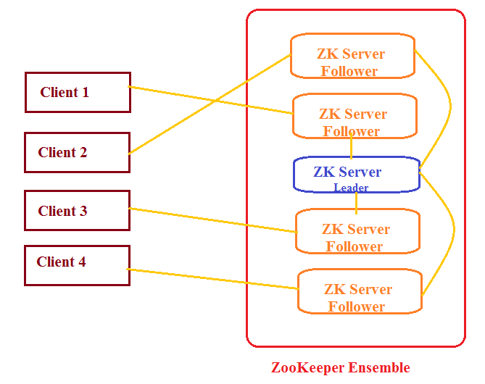
Apache ZooKeeper Fundamentals
Architecture

Slide 8
Apache ZooKeeper Fundamentals
Architectural Components
  Client
    Node in distribution application, tries to connect to server in ensemble.
    Sends heartbeat message to server to maintain the connection
    In response, server sends message back to client, otherwise client connects to other server
  Server
    Node in our ZooKeeper ensemble, provides all the services to clients
    Gives acknowledgement to client to inform that the server is alive.
  Ensemble
    Cluster of ZooKeeper servers. The minimum number of nodes - 3.
  Leader
    Server node which performs automatic recovery if any of the connected node failed.
    Leaders are elected on service startup.
  Follower
    Server node which follows leader instruction.

Slide 9
Apache ZooKeeper Fundamentals
Hierarchical Namespace
  ZooKeeper node is referred as znode.
  Every znode is identified by a name and separated by a sequence of path .
  Each znode can store upto 1MB of data
  The main purpose of this structure is to store synchronized data and describe the metadata of the znode.
  Every znode in the ZooKeeper data model maintains a stat structure.
  A stat simply provides the metadata of a znode. It consists of Version number, Action control list , Timestamp, and Data length

Slide 10
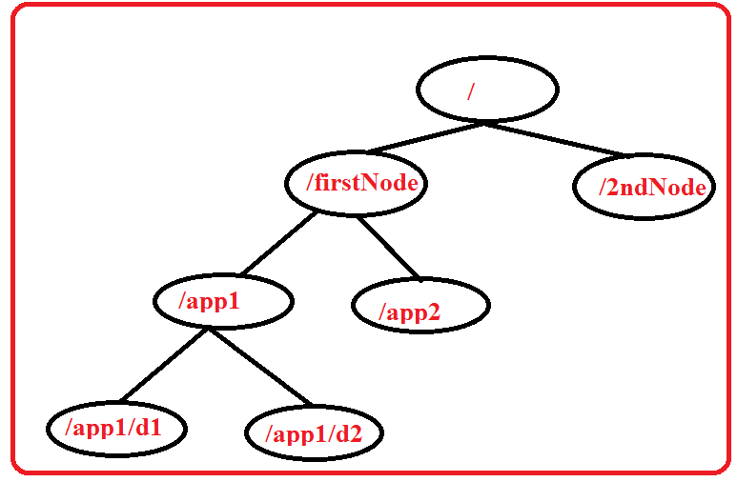
Apache ZooKeeper Fundamentals
Hierarchical Namespace(2)

Slide 11
Apache ZooKeeper Fundamentals
Types of Znodes
  Persistence znode
  Ephemeral znode
  Sequential znode

Slide 12
Apache ZooKeeper Fundamentals
Persistence znode
  is alive even after the client, which created that particular znode, is disconnected.
  By default, all znodes are persistent.
  Ephemeral znode
  are active until the client is alive.
  When a client gets disconnected from the ZooKeeper ensemble, then the ephemeral znodes get deleted automatically.
  are not allowed to have a children further
  play an important role in Leader election

Slide 13
Apache ZooKeeper Fundamentals
Sequential znode
  can be either persistent or ephemeral
  ZooKeeper sets the path of the znode by attaching a 10 digit sequence number to the original name.
  For example, if a znode with path /myapp is created as a sequential znode, ZooKeeper will change the path to /myapp0000000001 and set the next sequence
  number as 0000000002.
  Sequential znodes play an important role in Locking and Synchronization.

Slide 14
Apache ZooKeeper
Sessions
  Requests in a session are executed in FIFO order.
  Once a client connects to a server, the session will be established and a session id is assigned to the client.
  The client sends heartbeats at a particular time interval to keep the session valid.
  If the ZooKeeper ensemble does not receive heartbeats from a client for more than the period specified at the starting of the service, it decides that the client died.
  When a session ends for any reason, the ephemeral znodes created during that session also get deleted.

Slide 15
Apache ZooKeeper
Watches
  Simple mechanism for the client to get notifications about the changes in the ZooKeeper ensemble.
  Clients can set watches while reading a particular znode.
  Watches send a notification to the registered client for any of the znode changes.
  Znode changes are modification of data associated with the znode or changes in the znode’s children.
  Watches are triggered only once.
  If a client wants a notification again, it must be done through another read operation.
  When a connection session is expired, the client will be disconnected from the server and the associated watches are also removed.

Slide 16
ZooKeeper Workflow – Connection
Connecting to Server
  Once a ZooKeeper ensemble starts, it will wait for the clients to connect.
  Clients will connect to one of the nodes in the ZooKeeper ensemble. It may be a leader or a follower node.
  Once a client is connected, the node assigns a session ID to the particular client and sends an acknowledgement to the client.
  If the client does not get an acknowledgment, it simply tries to connect another node in the ZooKeeper ensemble.
  Once connected to a node, the client will send heartbeats to the node in a regular interval to make sure that the connection is not lost.

Slide 17
ZooKeeper Workflow – Read
Reading data from znode
  If a client wants to read a particular znode, it sends a read request to the node with the znode path and the node returns the requested znode by getting it from its own database.
  For this reason, reads are fast in ZooKeeper ensemble.

Slide 18
ZooKeeper Workflow – Write
Writing to znode
  If a client wants to store data in the ZooKeeper ensemble, it sends the znode path and the data to the server.
  The connected server will forward the request to the leader and then the leader will reissue the writing request to all the followers.
  If only a majority of the nodes respond successfully, then the write request will succeed and a successful return code will be sent to the client.
  Otherwise, the write request will fail. The strict majority of nodes is called as Quorum.

Slide 19
ZooKeeper Workflow – nodes failure
Nodes in a ZooKeeper Ensemble
  If we have a single node, then the ZooKeeper ensemble fails when that node fails. It contributes to "Single Point of Failure" and it is not recommended in a production environment.
  If we have two nodes and one node fails, we don’t have majority as well, since one out of two is not a majority.
  If we have three nodes and one node fails, we have majority and so, it is the minimum requirement. It is mandatory for a ZooKeeper ensemble to have at least three nodes in a live production environment.
  If we have four nodes and two nodes fail, it fails again and it is similar to having three nodes. The extra node does not serve any purpose and so, it is better to add nodes in odd numbers, e.g., 3, 5, 7.
  A write process is expensive than a read process in ZooKeeper ensemble, since all the nodes need to write the same data in its database. So, it is better to have less number of nodes than having a large number of nodes for a balanced environment.

Slide 20
ZooKeeper Command Line Interface
CLI
  ZooKeeper Command Line Interface is used to interact with the ZooKeeper ensemble for development purpose.
  Can perform the following operation
    Create znodes
    Get data
    Watch znode for changes
    Set data
    Create children of a znode
    List children of a znode
    Check Status
    Remove / Delete a znode

Slide 21
ZooKeeper Java API
Basics of ZooKeeper API
  Application interacting with ZooKeeper ensemble is referred as ZooKeeper Client or simply Client.
  Znode is the core component of ZooKeeper ensemble and ZooKeeper API provides a small set of methods to manipulate all the details of znode with ZooKeeper ensemble.
  A client should follow the steps given below to have a clear and clean interaction with ZooKeeper ensemble.
    Connect to the ZooKeeper ensemble. ZooKeeper ensemble assign a Session ID for the client.
    Send heartbeats to the server periodically. Otherwise, the ZooKeeper ensemble expires the Session ID and the client needs to reconnect.
    Get / Set the znodes as long as a session ID is active.
    Disconnect from the ZooKeeper ensemble, once all the tasks are completed. If the client is in

Slide 22
ZooKeeper Java API (2)
ZooKeeper Class
  The central part of the ZooKeeper API is ZooKeeper class.
  It provides options to connect the ZooKeeper ensemble in its constructor and has the following methods -
    connect - connect to the ZooKeeper ensemble
    create - create a znode
    exists - check whether a znode exists and its information
    getData - get data from a particular znode
    setData - set data in a particular znode
    getChildren - get all sub-nodes available in a particular znode
    delete - get a particular znode and all its children
    close - close a connection

Slide 23


Reference
  Apache ZooKeeper Documentation
    https://zookeeper.apache.org/
    https://zookeeper.apache.org/doc/r3.4.14/
    https://www.tutorialspoint.com/zookeeper/zookeeper_api.htm
  Real-Time Analytics , Byron Ellis
    Chapter 3 : Service Configuration and Coordination

